Slide 1
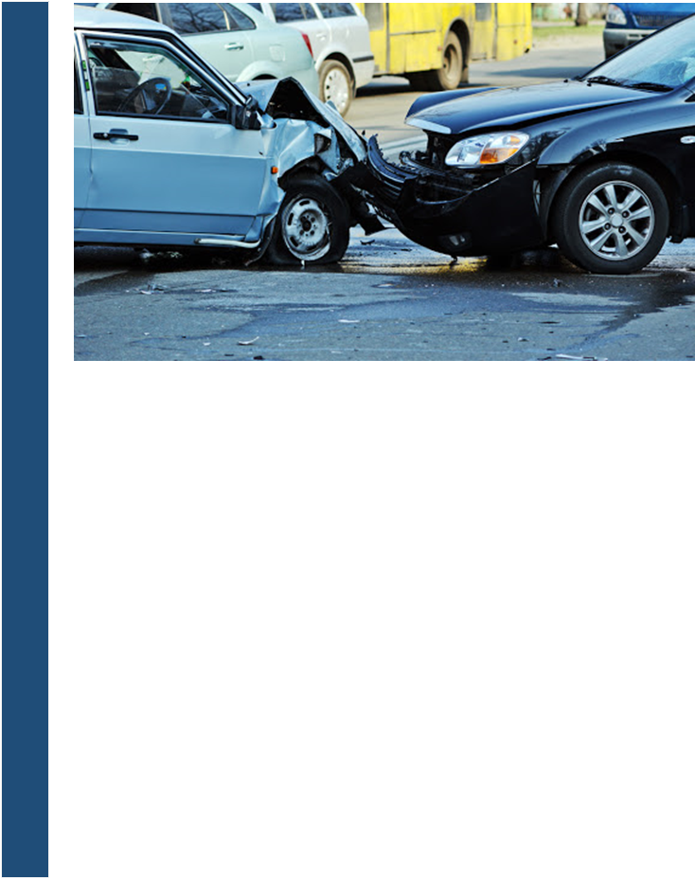
LOS ANGELES TRAFFIC COLLISION ANALYSIS
IDENTIFYING PATTERNS AND CORRELATIONS IN ORDER TO HELP REDUCE CRASHES AND POTENTIALLY SAVE LIVES
Debasis Chatterjee, Christopher Webster, Dalis Riley, Jonathan Ortiz
IST 652 SCRIPTING FOR DATA ANALYSIS
Professor Jason Anastasopoulos
Syracuse University | 2020

Slide 2
Introduction
We wanted to do a project based around traffic accidents and areas where they commonly occur. The analysis focused on Los Angeles, which is the second largest metropolitan area in the nation. With a population of 13.1 million people, the number of traffic accidents continue to grow as the number of residents increases.
The goal of this analysis is to explore the trends and correlations between the data to provide useful information that can help answer our proposed analysis questions:
What are the most dangerous intersections?
What are the most common collision areas in Los Angeles?
What are the best/worst times of the day for accidents? Best/worst month?
What is the demographic makeup of victims in collisions?
What is the relationship between income and collision victims?
Do certain temperatures or weather play a factor?

Slide 3
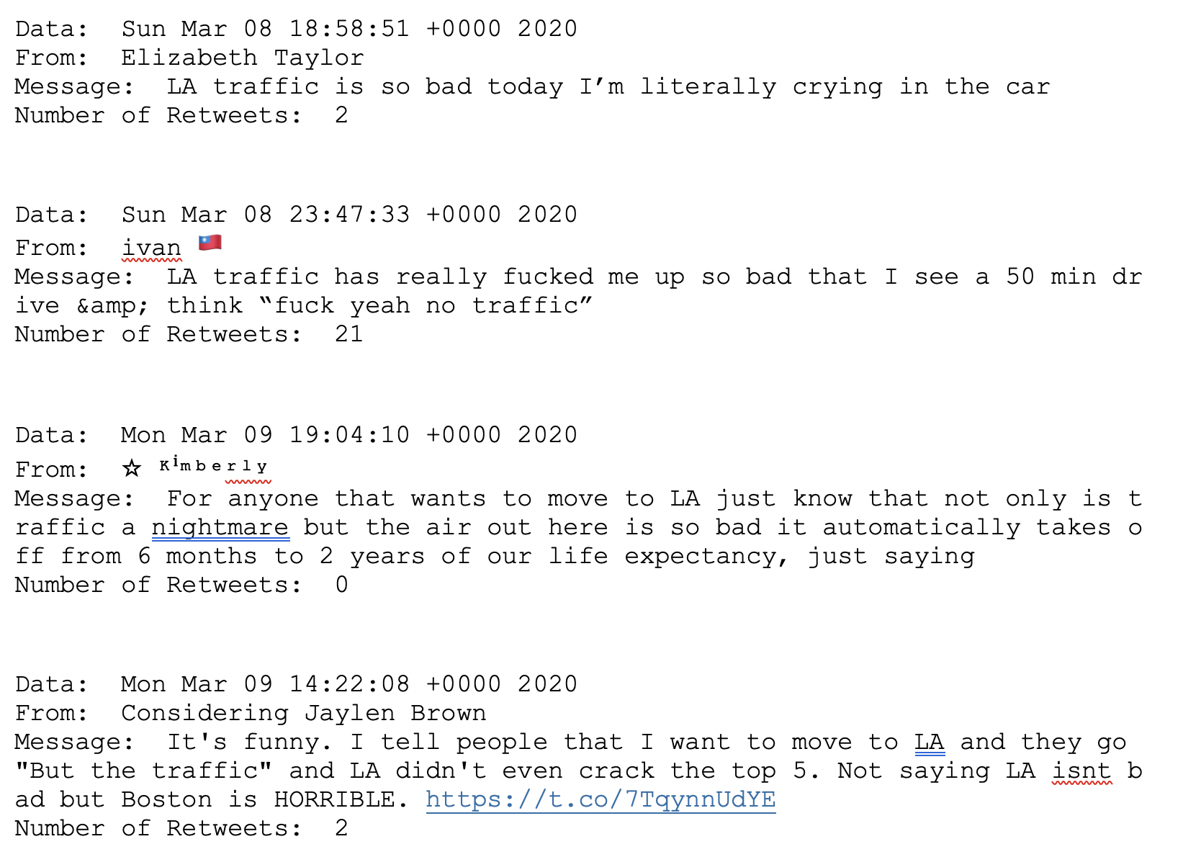
A Look at Twitter Users Tweets

Slide 4
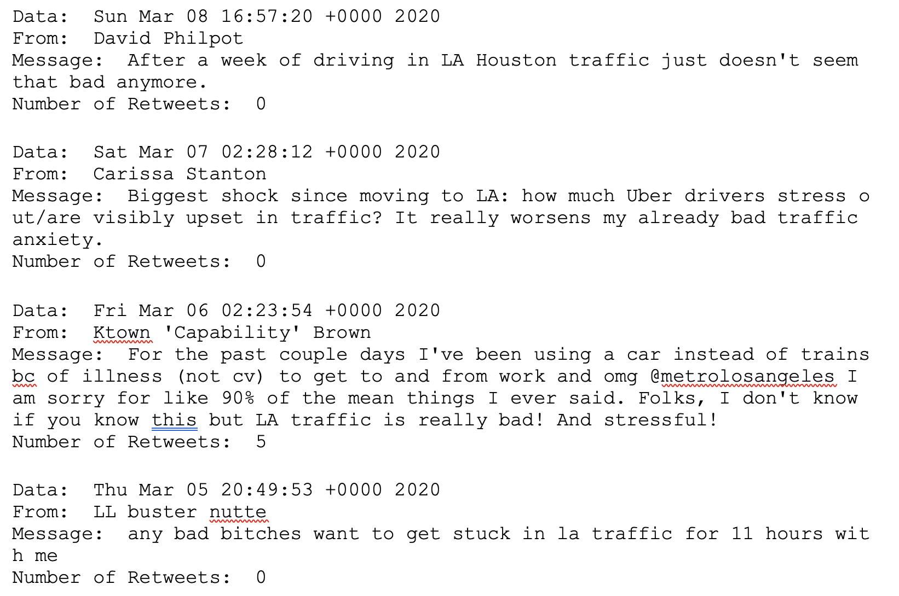
A Look at Twitter Users Tweets

Slide 5
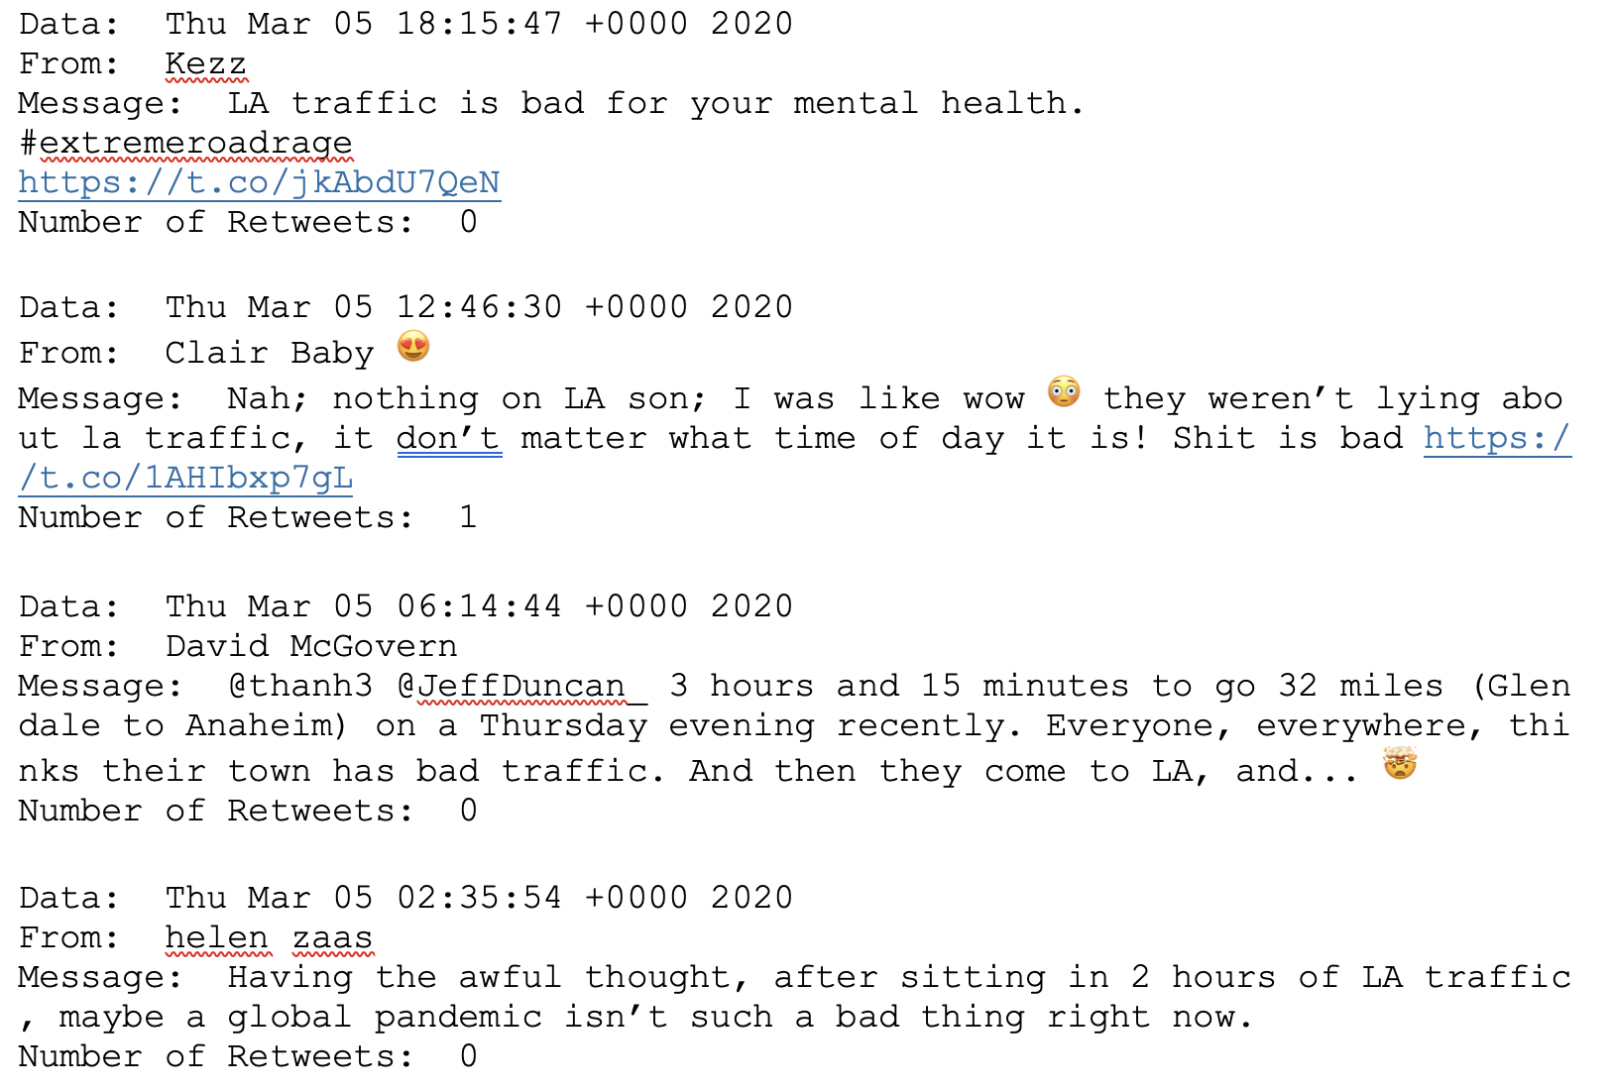
A Look at Twitter Users Tweets

Slide 6
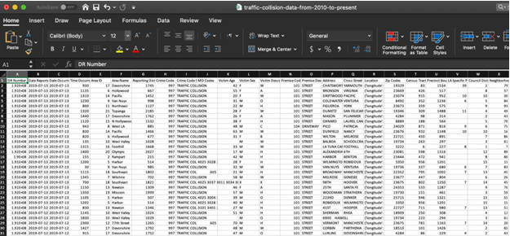
Original Dataset
The Los Angeles Traffic Collision Data is publicly available from Kaggle.com is owned by the City of Los Angeles.
This dataset contains 481,568 incidents from 2010 to 2019. Since the dataset continually updates on Kaggle, our latest download of the dataset happened on July 19, 2019.
Multiple data sets were incorporated into analysis beyond the original Kaggle dataset in order to get more data that was not included in this original dataset such as weather and income data.

Slide 7
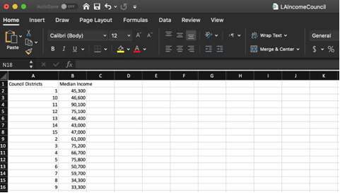
Median Income Dataset
To answer the analysis question about income, outside data was needed since the original dataset did not have income information.
For Median Income, data was pulled from the LA Chamber of Commerce website and the Council Districts in Los Angeles.
Other ways were examined to link income to our dataset but Council District was found to be the most effective way to merge income with the rest of the data.
Source: https://lachamber.com/clientuploads/pdf/2018/18_BeaconReport_LR.pdf

Slide 8
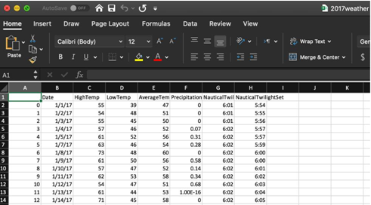
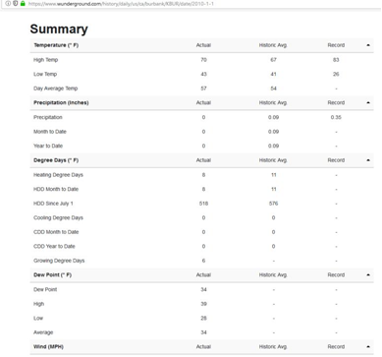
Weather Dataset
The weather data was scraped from the website Wunderground.com.
Data from 2017, 2018, and 2019 was gathered, but since 2019 was not complete, we decided to only import 2017 and 2018.
This led us to the scope of our project focusing on only the years of 2017 and 2018.

Slide 9
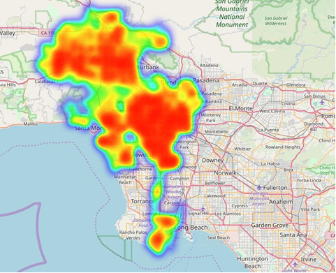
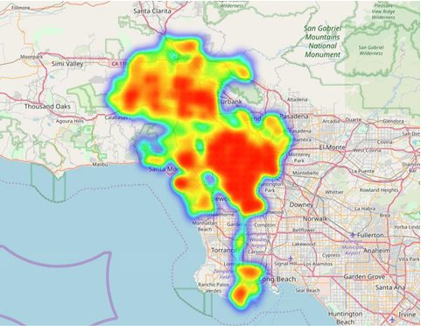
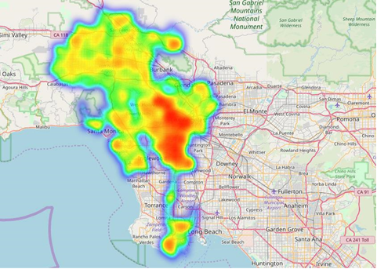
Analysis Location
These three heatmaps highlight how the center of LA has the most crashes at all times of the day.
The map of crashes when it is visibly dark shows the northern part of LA has less accidents at night.

Slide 10
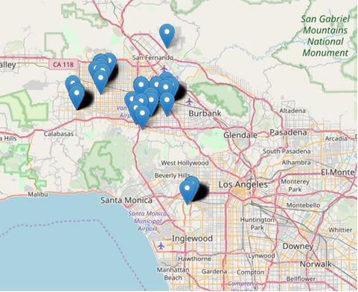
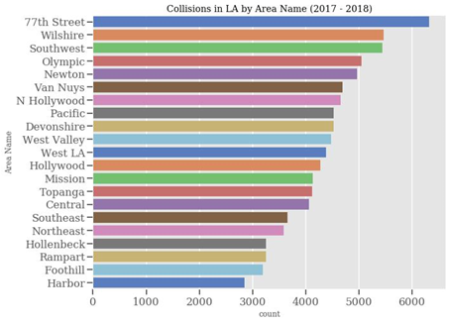
Collisions By Area
Although the middle of Los Angeles had the most concentration of collisions, the northern parts near Burbank had unique combinations with more frequent accidents.
These areas may need further analysis to determine what some of the underlining issues may be that are causing high collision volume.

Slide 11
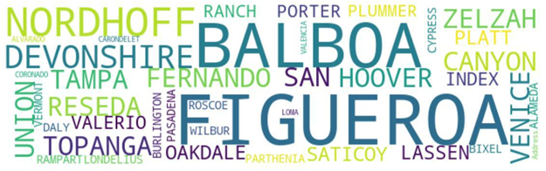
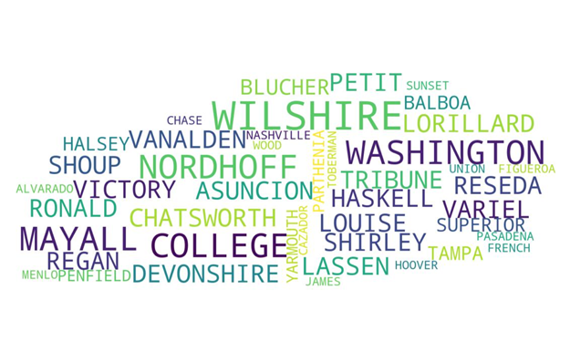
Collisions By Street Name
Figure 12 displays a concentration of street names from the Address field were examined to see which streets were involved in the most collisions.
Figure 13 similarly shows the concentration of street names by the cross street involved in the highest number of collisions.
When combining the cross streets with addresses, we were able to determine the top 8 streets with the most collisions.
FIGURE 12 - WORD CLOUD OF ADDRESS STREETS INVOLVED IN COLLISIONS
FIGURE 13 - WORD CLOUD OF CROSS STREETS INVOLVED IN COLLISIONS

Slide 12
Collisions By Gender
For Asians and Blacks, the gender breakdown of victims is fairly even, near 50%, which is in line with the 50% gender divide in Los Angeles among all races.
For Whites and Hispanics, though, males make up 60% of the gender of victims within the same race.
This is an interesting deviation from the standard 50/50 gender divide in the Los Angeles population. This could be due to a culture differences or some other factor. It would be interesting for further examination.

Slide 13
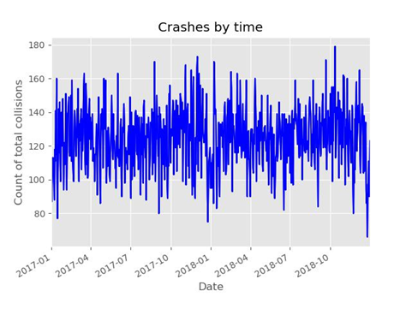
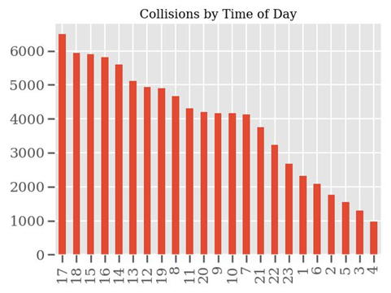
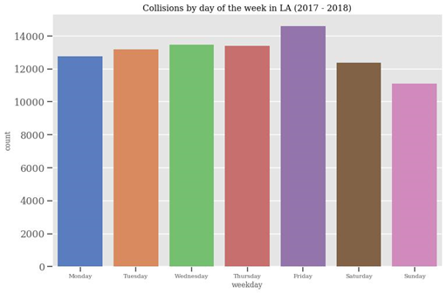
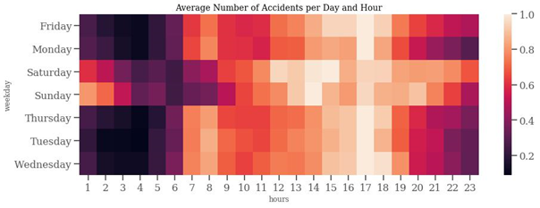
Collisions By Day and Time
Analysis by day and time show commonality between each visual.
For example, weekdays after 2pm show an increase in accidents.

Slide 14
Conclusions
Los Angeles is a large and growing city which continues to attract more residents and vehicles. With the increase in the number of cars on the road comes additional traffic collisions and congestion. The analysis of the 2017-2018 data provides some interesting insights that can be used by a variety of people who are interested in LA traffic. Below are a few of the observations from this analysis.
What are the most dangerous intersections? What are the most common collision areas in Los Angeles?
⬧ SEPULVEDA BL & SHERMAN WY  77th Street Area
⬧ NORDHOFF ST & TAMPA AV  Council Districts 12/13/14
⬧ WHITSETT AV & SHERMAN WY  Generally in the heart of LA
⬧ RODEO RD & LA BREA AV
What are the best/worst times of the day for accidents? What patterns occur due to the amount of natural sunlight?
Best/worst month?
⬧ Friday has the highest frequency of collisions  There appears to be a significantly less concentration of
⬧ Sunday has the fewest amount of collisions accidents in Northern LA during the night time
⬧ March and October have the highest number of collisions  The highest frequency of accidents is on Monday through
⬧ The hours between 12PM to 5PM have the highest frequencies between 4-5pm
of collisions

Slide 15
Recommendations
The results of this study provide additional insights that can be used by city planners, government officials and citizens to better understand the Los Angeles traffic conditions sin 2017 and 2018. We recommend the use of this information in the following areas:
Additional studies of dangerous intersections and locations
Warnings on interactive road signs during rush hour when it is raining
Utilize this data and interactive maps for planning sessions with subject matter experts and citizens when starting new projects which impact roadways
Public service campaign to educate the public with targeted messages to men

